Slide 1
University of Diyala
College of Engineering
Department of Electronics Engineering
Course Number: U103
Course Name: Computer Science
Lecture (8)
Asst. Lect. Wurod Qasim Mohamed

Slide 2
Microsoft office Power Point Presentation

Slide 3
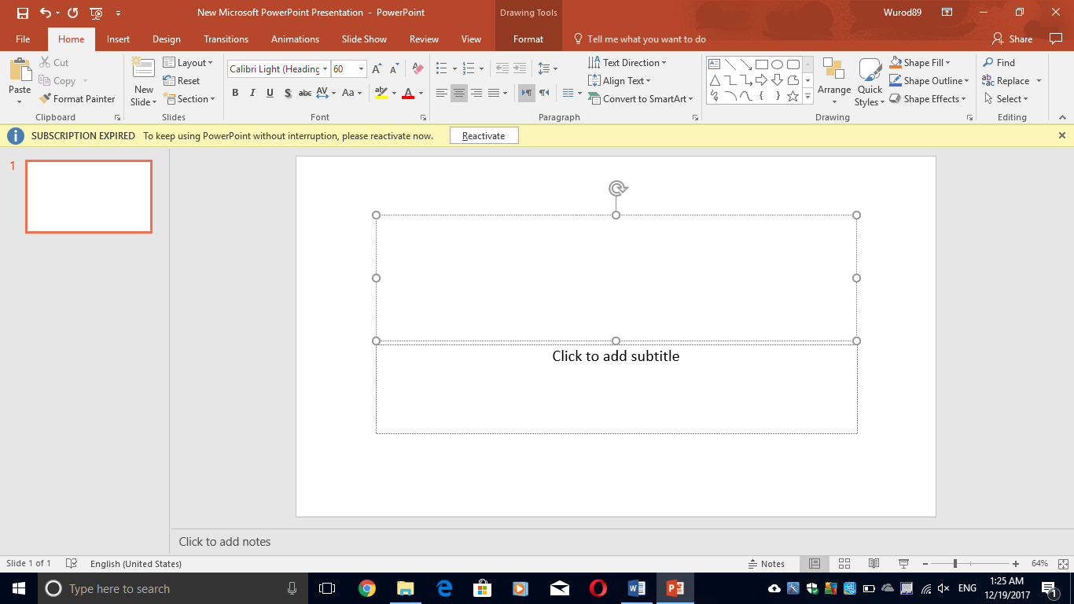

Slide 4
Tool bars of File, Home, and Insert are almost the same as Microsoft office Word with replacing “document” with “Slide”.
There is a new option in Insert bar:
Slides: help you to add a new slide (Ctrl + M) to your file.

Slide 5
Tool bar of Design:
Themes: help you to select theme to your document in which each theme uses its own unique set of colors, fonts, and effects to create the overall look and feel of your side.
Variants: help you to customize the look of the current design.
Customizes:
Slide size: change the size of the slides in the presentation.
Format Background: Fine-tune the formatting for your background or hide design elements from the current design.

Slide 6
Tool bar of Transition:
Preview: help you to play the transition to this slide.
Transition to this Slide: help you to pick a special effect for your transition between the previous slide and this one.
Timing:
Sound: help you to pick a sound to play during the transition from the previous slide to this one.
Duration: help you to specify the length of the transition.
Apply to All: help you to apply the current slide’s transition, effects, and timing settings to the entire presentation.
Advance slide: help you to select the moving option to the next slide for example (on Mouse Click) (After Specific time that you will determine)

Slide 7
Tool bar of Animations:
Preview: help you to play the animations on this slide
Animation: help you to pick an animation to apply to the selected objects on this slide.
Timing:
Start: help you to pick the starting point of the selected object
On click
With previous
After previous
Duration: help you to specify the length of an animation.
Delay: help you to play the animation after a certain number of seconds.

Slide 8
Tool bar of Slide Show:
Start Slide Show:
From Beginning (F5)
From Current Slide (Shift + F5)
Setup:
Hide Slide: help you to hide the current slide so that it will not appear when you are presenting.
Tool bars of Review and View are almost the same as Microsoft office Word Program.
There is no Pag Layout tool bar in the Microsoft office Power Point.

Slide 9
Practical Laboratory Part

